Slide 1

Made by -
Ratul banerjee
Email: ratulxx@gmail.com
Mobile no: 9830880419

Slide 2
Brief Explanation of Idea:
Prototype submission building solution on azure cloud using the theme of mobility
Azure Maps and accessibility
Azure Maps makes it easy for all users to navigate an interactive map experience. Users can interact with maps using a mouse, touch, or keyboard. Azure Maps provides screen readers with enhanced descriptions that can combine multiple updates into a single message that is easier to digest and understand. Recently Azure Maps achieved exciting new capabilities & Microsoft certification around accessibility. All apps, both Microsoft owned and third party, that use Azure Maps will benefit from the accessibility features that are provided out of the box.
Azure Maps also relies on best of breed content partnerships for everything from the maps data, traffic, real time transit, ride share, to weather data.
Moovit helps people with disabilities ride transit
One of the Azure Maps content partnerships is with Moovit. Launched in 2011 in Israel, Moovit has become the world’s most popular transit-planning and navigation app, with more than 500 million users and service in over 3,000 cities across 94 countries. The company is also a leader in inclusive technology, with innovative work that helps people across the disability spectrum use buses, trains, subways, ride-hailing services, and other modes of public transit.
In addition to offering a consumer app in 45 languages, Moovit has partnered with Microsoft to provide its multi-modal transit data to developers who use Azure Maps, and a set of mobility-as-a-service solutions to cities, governments, and organizations. The partnership will enable the creation of more inclusive smart cities and more accessible transit apps.

Slide 3

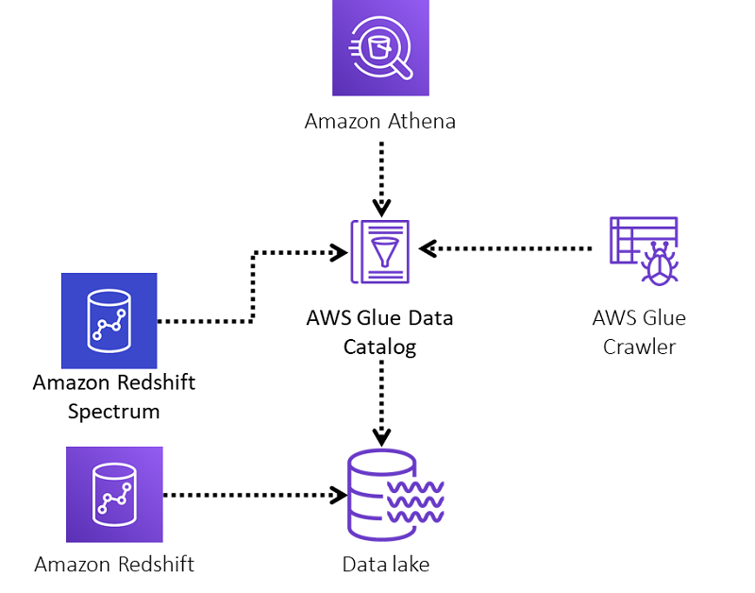
Moovit, with the support of AWS, implemented a lake house architecture by employing the following best practices:
Unloading data into Amazon Simple Storage Service (Amazon S3)
Instituting a hot/cold pattern using Amazon Redshift Spectrum
Using AWS Glue to crawl and catalog the data
Querying data using Athena

Slide 4
Technology/Tool Stack Used:
An AWS account.
An Amazon Redshift cluster.
The following AWS services and access: Amazon Redshift, Amazon S3, AWS Glue, and Athena.
The appropriate AWS Identity and Access Management (IAM) permissions for Amazon Redshift Spectrum and AWS Glue to access Amazon S3 buckets. For more information, see IAM policies for Amazon Redshift Spectrum and Setting up IAM Permissions for AWS Glue.

Slide 5
Azure Cloud services used:
Moovit uses an Amazon Redshift cluster to allow different company teams to analyze vast amounts of data. They wanted a way to extend the collected data into the data lake and allow additional analytical teams to access more data to explore new ideas and business cases.
MOOVIT EMBRACES DATA LAKE ARCHITECTURE BY EXTENDING THEIR AMAZON REDSHIFT CLUSTER TO ANALYZE BILLIONS OF DATA POINTS EVERY DAY
Moovit is a leading Mobility as a Service (MaaS) solutions provider and maker of the top urban mobility app. Guiding over 800 million users in more than 3,200 cities across 103 countries to get around town effectively and conveniently, Moovit has experienced exponential growth of their service in the last few years. The company amasses up to 6 billion anonymous data points a day to add to the world’s largest repository of transit and urban mobility data, aided by Moovit’s network of more than 685,000 local editors that help map and maintain local transit information in cities that would otherwise be unserved.

Slide 6
Brief summary of the application/website:
Steps as follows in moovit :
Unloading data from Amazon Redshift to Amazon S3
Creating a Data Catalog with an AWS Glue crawler
Querying the data lake in Athena
Querying Amazon Redshift and the data lake using a unified view with Amazon Redshift Spectrum

Slide 7
Source code in zip file/Github link:
UNLOAD ('select o_orderkey, o_custkey, o_orderstatus, o_totalprice, o_orderdate, o_orderpriority, o_clerk, o_shippriority, o_comment, skip
FROM tpc.orders
ORDER BY o_orderkey, o_orderdate')
TO 's3://tpc-bucket/orders/'
CREDENTIALS 'aws_iam_role=arn:aws:iam::<account_number>:role/>Role<'
FORMAT AS parquet allowoverwrite PARTITION BY (o_orderdate);
CREATE EXTERNAL SCHEMA spectrum
FROM data catalog
DATABASE 'datalake'
iam_role 'arn:aws:iam::<account_number>:role/mySpectrumRole'
CREATE EXTERNAL DATABASE IF NOT EXISTS;
SELECT * FROM spectrum.orders;
CREATE OR REPLACE VIEW lake_house_joint_view AS (SELECT * FROM public.orders WHERE o_orderdate >= dateadd(‘day’,-90,date_trunc(‘day’,getdate()))
UNION ALL SELECT * FROM spectrum.orders WHERE o_orderdate < dateadd(‘day’,-90,date_trunc(‘day’,getdate())) WITH NO SCHEMA BINDING;

Slide 8
Prototype Demo(Video/Screenshots):

